Slide 1
COLLAB LINK
TEAM MEMBERS
1. Dhilip M
2.Akhila M
3.Jagan D

Slide 2
ABSTRACT
The CIPD department faces challenges in:
  Efficiently communicating event information to students.
  Encouraging active student participation in events.
There is currently no platform for:
  Students to share their ideas and insights.
  Peer engagement through comments, likes, and collaborative discussions.
This project aims to:
  Develop a centralized platform to streamline event notifications.
  Foster an interactive environment to enhance student engagement and collaboration.

Slide 3
INTRODUCTION
The CIPD department currently lacks an efficient system for informing students about upcoming events.
There is no platform for students to easily share ideas or interact with peers.
This project aims to develop a centralized platform that addresses these challenges.
The platform will enhance event communication, making it easier for students to stay informed.
It will encourage student participation in events, increasing engagement.
The platform will include interactive features, such as sharing ideas, liking, and commenting, to foster
collaboration.

Slide 4
EXISTING SYSTEM
1.Microsoft Teams
A collaboration platform with real-time chat, file sharing, and scheduling.
2. Google Classroom
An online tool for managing coursework, announcements, and assignments.
3. Slack
A messaging app designed for team communication and collaboration.
4. Campus-Specific Portals
Institution-specific platforms for student information, event updates, and resources.

Slide 5
DISADVANTAGES OF THE EXISTING SYSTEM
Lack of tailored notifications specifically for events.
Limited interactivity for students to engage with announcements or each other.
Hard to track event-specific discussions or idea-sharing.
Few options to encourage student participation through likes, comments, or other interactive features.

Slide 6
PROPOSED SYSTEM AND ITS ADVATNGES
Proposed System
A centralized platform for the CIPD department focused on event notifications and student engagement, allowing students to receive updates, share ideas, and interact with peers.
Advantages
Streamlined Event Notifications: Delivers targeted, timely updates for upcoming events.
Enhanced Student Engagement: Provides features like likes, comments, and idea-sharing for collaborative interaction.
Centralized Information: Consolidates all event details in one accessible location.
Customizable Notifications: Allows students to subscribe to relevant events or topics.

Slide 7
REQUIREMENTS
Hardware Requirements
Server: High-performance server or cloud-based hosting (e.g., AWS, Azure).
Database Server: Reliable server for hosting MongoDB.
Network Infrastructure: Stable internet and network support for the platform.
User Devices: Laptops, smartphones, and tablets for accessing the platform.
Software Requirements (MERN Stack)
Frontend: React.js for building the user interface.
Backend: Node.js with Express for handling server-side logic.
Database: MongoDB for storing event data, user interactions, and ideas.
Version Control: Git for managing code versions.

Slide 8



DIAGRAMS
WireFrame Diagram

Slide 9
MODULES
Authentication Module:
  Handles user registration, login, and access control.
Event Management Module:
  Manages the creation, editing, and display of upcoming events.
Idea Sharing Module:
  Allows students to post ideas, comment, and like.
Notification System Module:
  Sends real-time notifications about upcoming events and user interactions.
Commenting and Liking System Module:
  Enables users to engage with ideas through comments and likes.

Slide 10
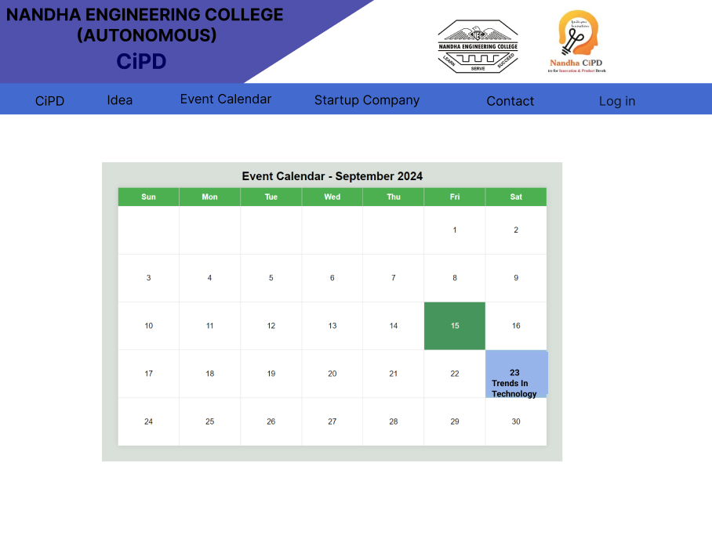
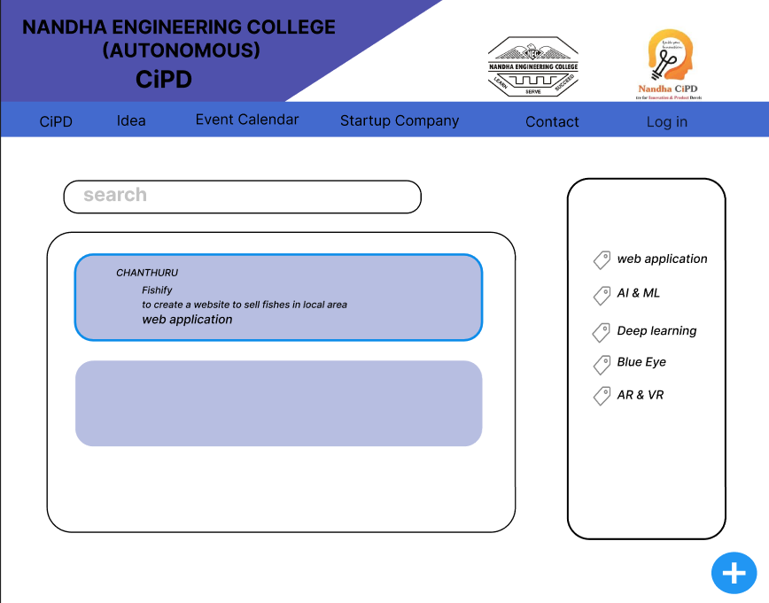
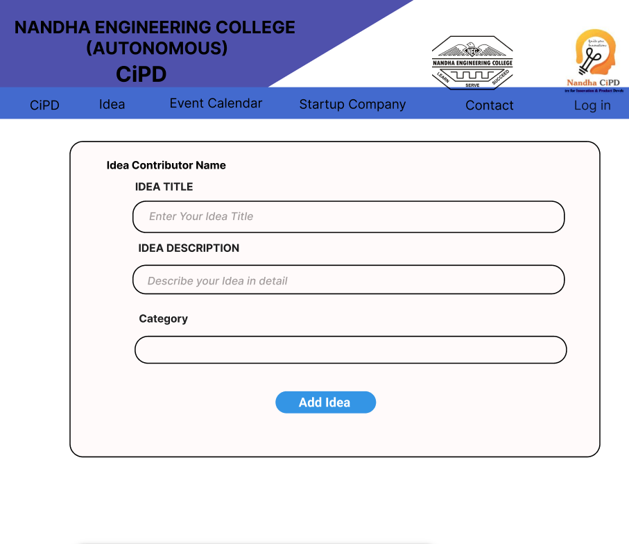
DESIGN OF THE PROJECT

Slide 11
CONCLUSION
The project successfully creates a centralized platform for efficient event notifications.
It provides a dedicated space for event updates and engagement.
The inclusion of interactive features fosters a more active student participation.
The platform encourages idea-sharing, promoting collaboration among students.
It significantly enhances communication between the CIPD department and students.
The project supports the development of a stronger, collaborative student community within the
department.

Slide 12
THANK YOU

